Slide 1
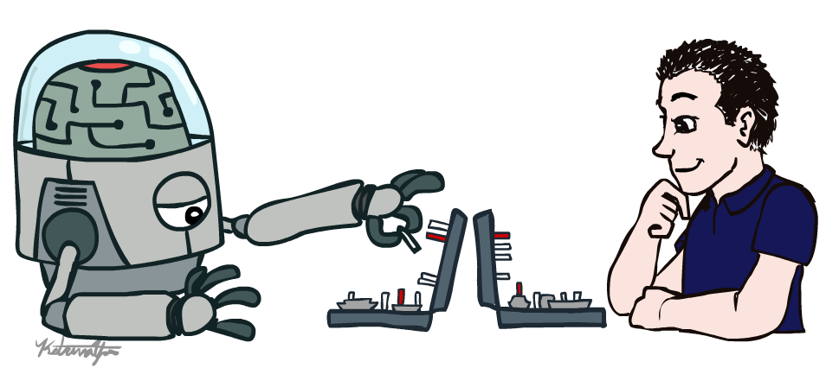
Introduction AI and ML
Instructor: Dr. Yeshwant Singh

Slide 2
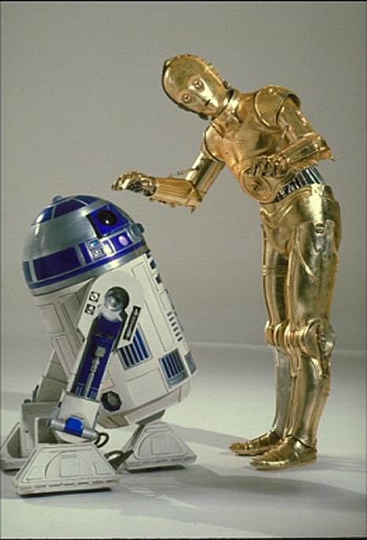
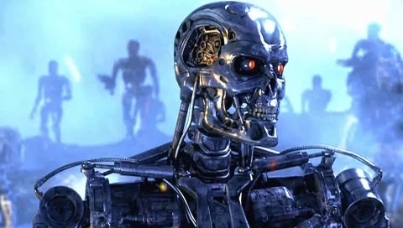
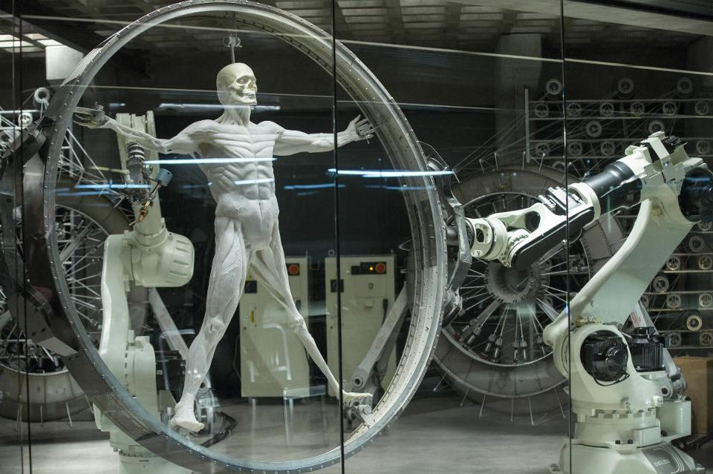
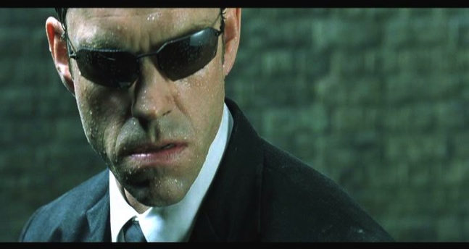
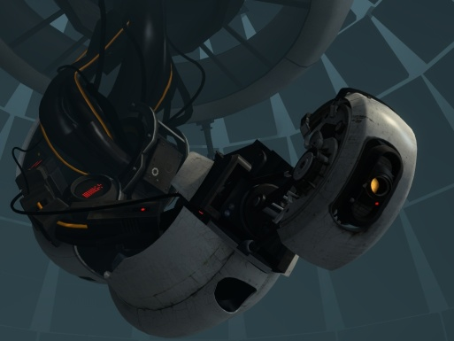
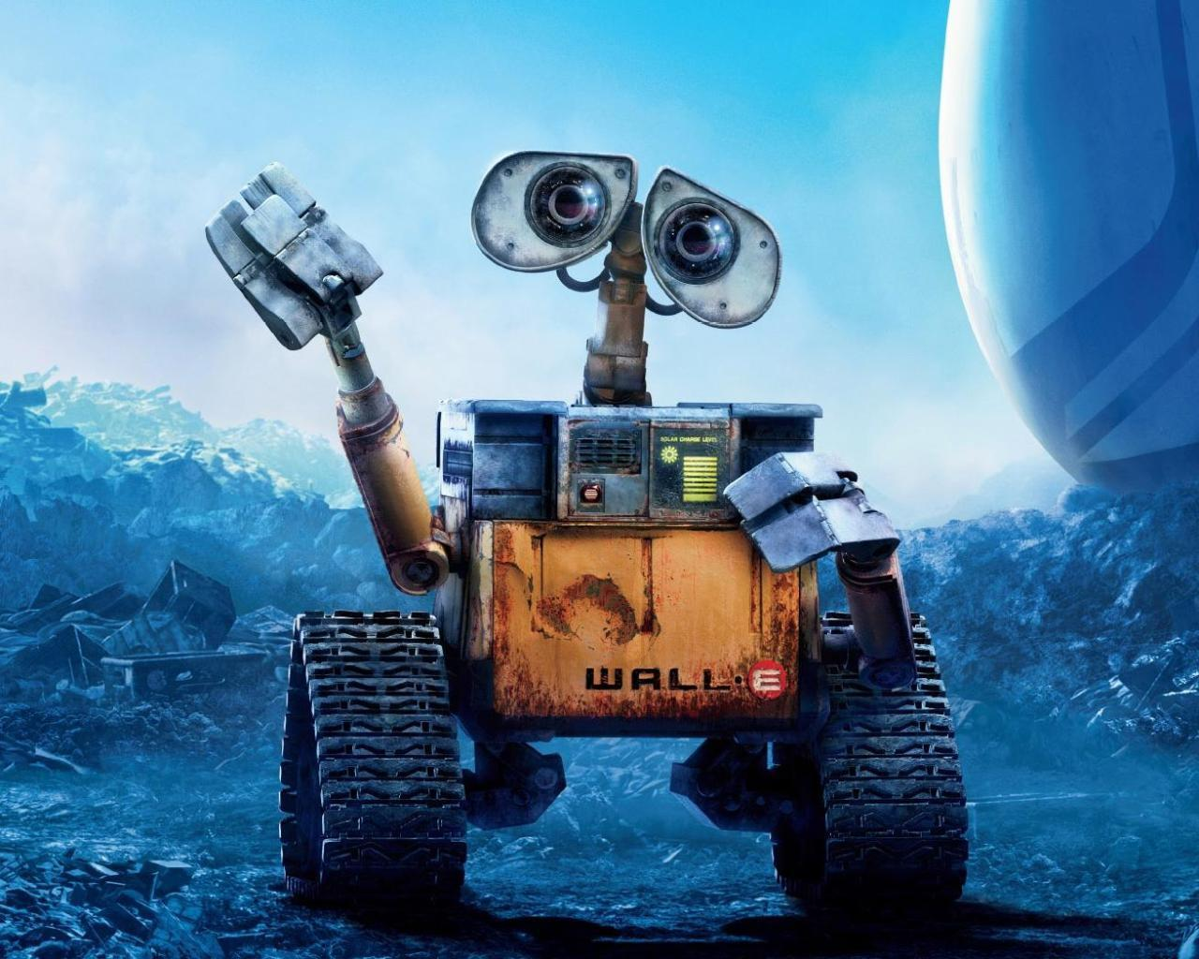
Sci-Fi AI?

Slide 3
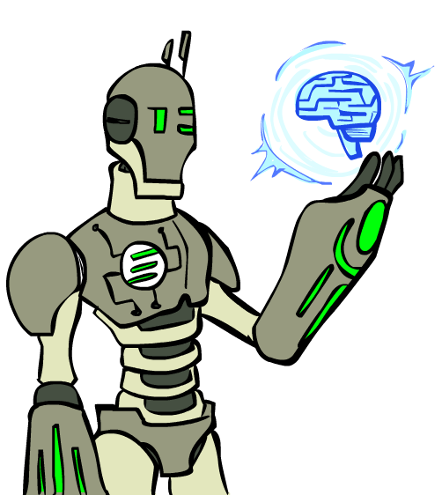
Today
What is artificial intelligence?
What can AI do?
What is this course?

Slide 4
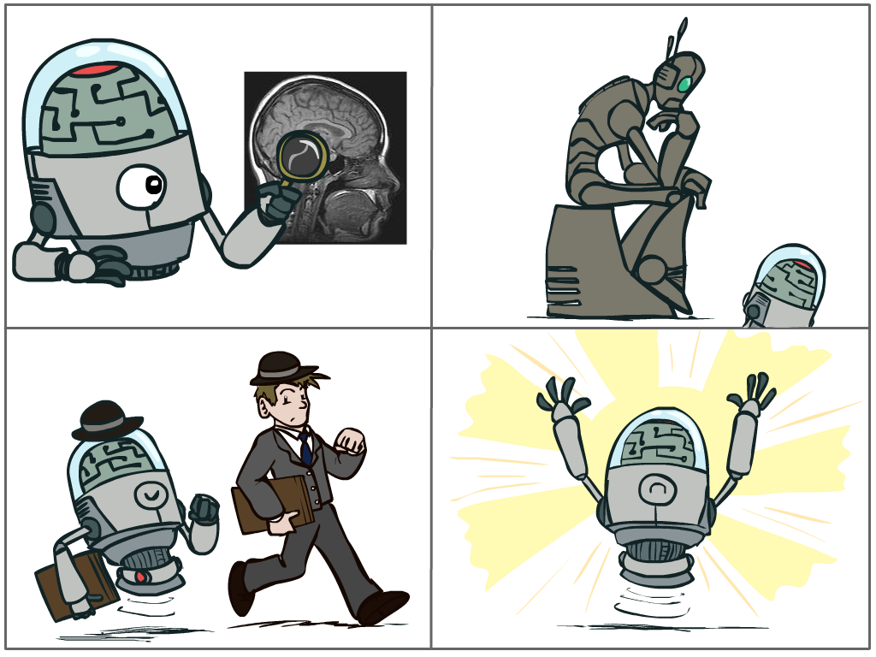
What is AI?
The science of making machines that:
Think like people
Think rationally
Act like people
Act rationally

Slide 5
Rational Decisions
We’ll use the term rational in a very specific, technical way:
Rational: maximally achieving pre-defined goals
Rationality only concerns what decisions are made
(not the thought process behind them)
Goals are expressed in terms of the utility of outcomes
Being rational means maximizing your expected utility
A better title for this course would be:
Computational Rationality

Slide 6
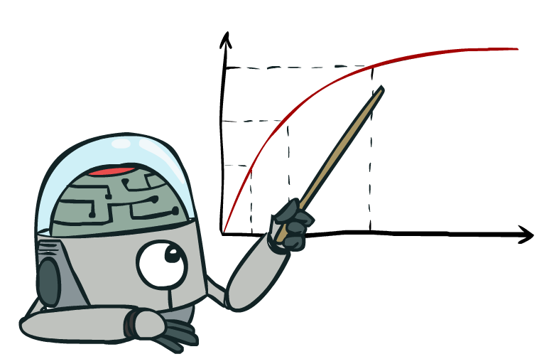
Maximize Your
Expected Utility

Slide 7
Maximize Your
Expected Utility
Notes:
Consequences of an action, context, other actors around
Convex Opt

Slide 8
Maximize Your
Expected Utility
Notes:
Related to -
Utilitarianism (Consequntialism) – Jeremy Bentham
Utility rather than values, could be
Virtue Ethics – Aristotle
Deontology (Duty based ethics)

Slide 9
Maximize Your
Expected Utility

Slide 10
Maximize Your
Expected Utility
Notes:
Very end – who is your? How do you get that?
Does the agent serve us? Important when figuring out if the agent is helping - many cues from philosophy here.
What is an agent that is good about acting for itself? Humans!
Replicating the brain would be an AI, right?

Slide 11
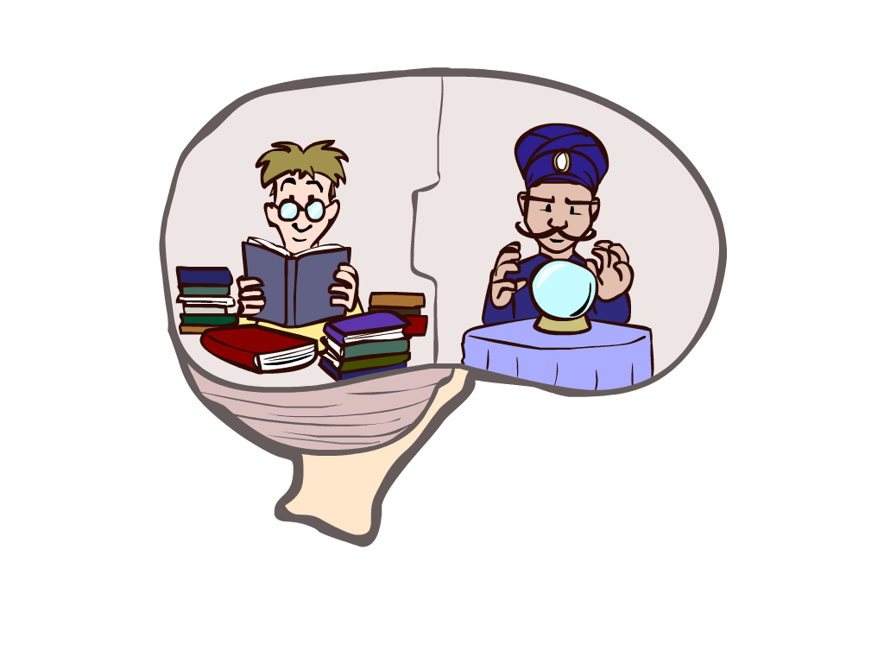
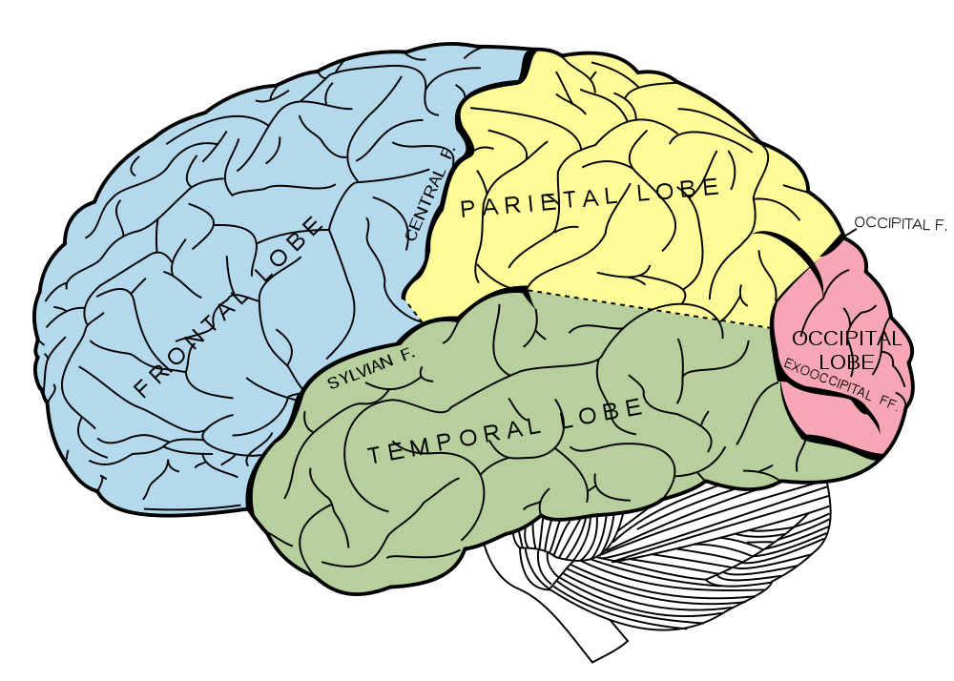
What About the Brain?
Brains (human minds) are very good at making rational decisions, but not perfect
Brains aren’t as modular as software, so hard to reverse engineer!
“Brains are to intelligence as wings are to flight”
Lessons learned from the brain: memory (data) and simulation (computation) are key to decision making

Slide 12
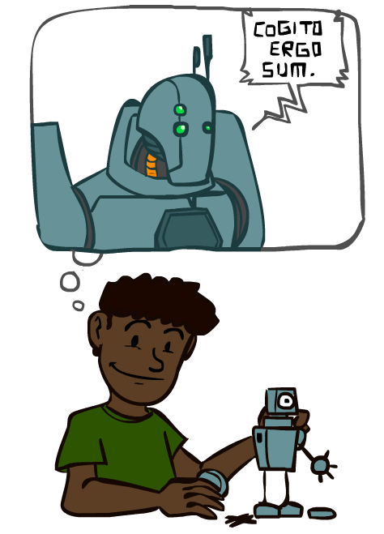
A (Short) History of AI
1940—1950: Early days
1943: McCulloch & Pitts: Boolean circuit model of brain
1950: Turing's “Computing Machinery and Intelligence”
1950—70: Excitement: Look, Ma, no hands!
1950s: Early AI programs, including Samuel's checkers program, Newell & Simon's Logic Theorist, Gelernter's Geometry Engine
1956: Dartmouth meeting: “Artificial Intelligence” adopted
1965: Robinson's complete algorithm for logical reasoning
1970—90: Knowledge-based approaches
1969—79: Early development of knowledge-based systems
1980—88: Expert systems industry booms
1988—93: Expert systems industry busts: “AI Winter”
1990—2012: Statistical approaches + subfield expertise
Resurgence of probability, focus on uncertainty
General increase in technical depth
Agents and learning systems… “AI Spring”?
2012—: Excitement: Look, Ma, no hands!
Big data, big compute, neural networks
Some re-unification of subfields
AI used in many industries

Slide 13
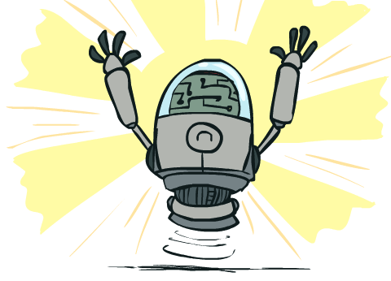
What Can AI Do?
Quiz: Which of the following can be done at present?
Play a decent game of Jeopardy?
Win against any human at chess?
Win against the best humans at Go?
Play a decent game of tennis?
Grab a particular cup and put it on a shelf?
Unload any dishwasher in any home?
Drive safely along the highway?
Drive safely along Telegraph Avenue?
Buy a week's worth of groceries on the web?
Buy a week's worth of groceries at Berkeley Bowl?
Discover and prove a new mathematical theorem?
Perform a surgical operation?
Translate spoken Chinese into spoken English in real time?
Write an intentionally funny story?

Slide 14
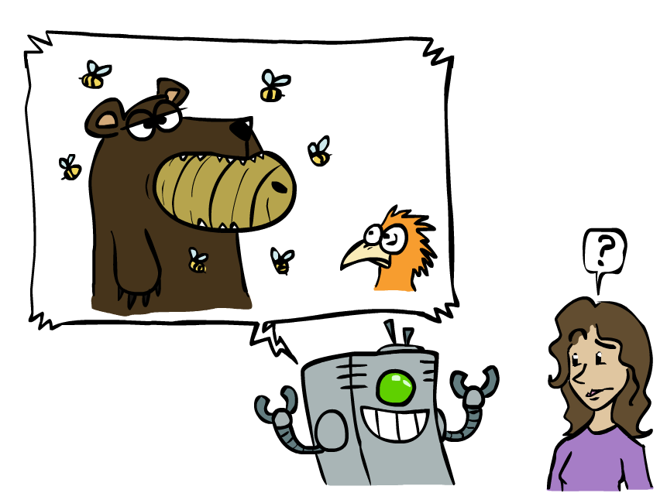
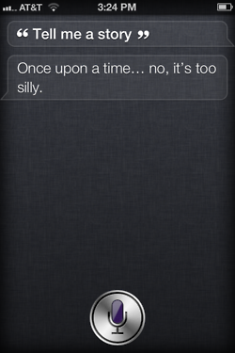

Unintentionally Funny Stories
One day Joe Bear was hungry. He asked his friend
Irving Bird where some honey was. Irving told him
there was a beehive in the oak tree. Joe walked to
the oak tree. He ate the beehive. The End.
Henry Squirrel was thirsty. He walked over to the
river bank where his good friend Bill Bird was sitting.
Henry slipped and fell in the river. Gravity drowned.
The End.
Once upon a time there was a dishonest fox and a vain crow. One day the crow was sitting in his tree, holding a piece of cheese in his mouth. He noticed that he was holding the piece of cheese. He became hungry, and swallowed the cheese. The fox walked over to the crow. The End.
[Shank, Tale-Spin System, 1984]
Notes:
1 – physically wrong, shouldn’t eat beehive
2 – forgot that in drowning not the force is most important but the drownee
3 – not physically wrong, not wrong in a language way, but wrong in the sense that it’s not aware of what is relevant to communicate and what is not
Siri – is that progress?

Slide 15
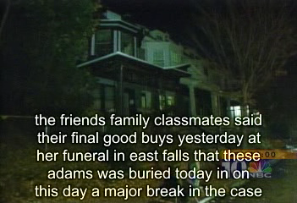
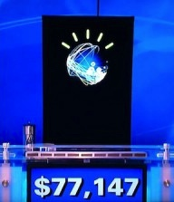
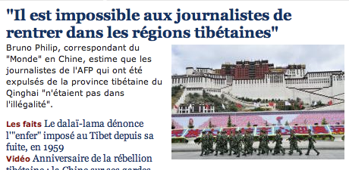
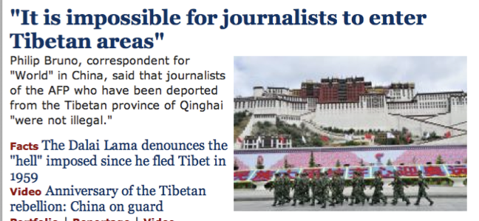
Natural Language
Speech technologies (e.g. Siri)
Automatic speech recognition (ASR)
Text-to-speech synthesis (TTS)
Dialog systems
Language processing technologies
Question answering
Machine translation
Web search
Text classification, spam filtering, etc…
https://play.aidungeon.io/
Notes:
Deepfake
chatbot examples
Do you know about IBM watson, Ken Jennings. Impressive because...
Expensive wayto win $70k
Figure out what she said, pertty good, hard to get intent
engaged in day to day basis
My favorite application is AI dungeon – you write commands to your fictional character and it becomes sort of like a book.
I can’t wait for something like this to work with images or clips (where technology is not far behind)

Slide 16
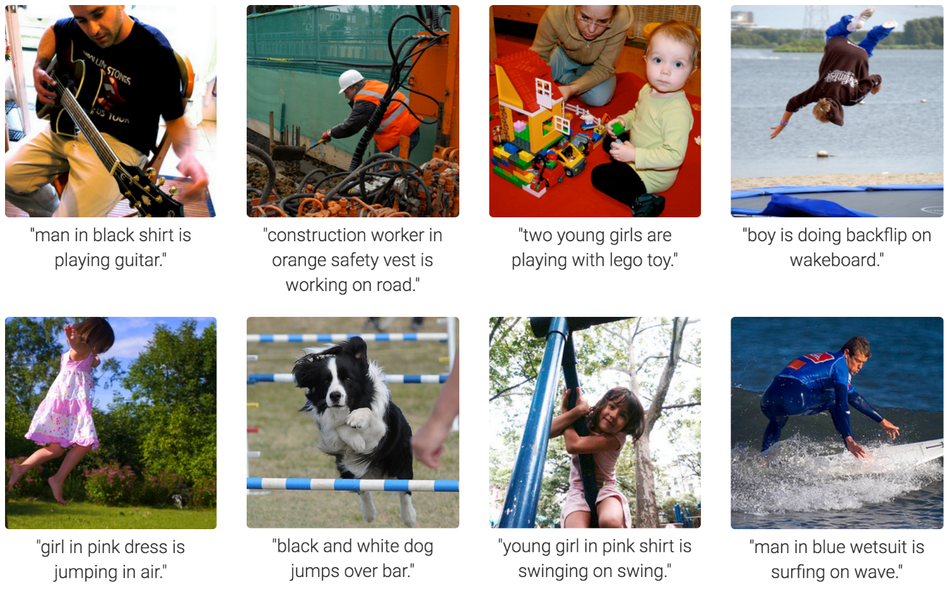
Computer Vision
Karpathy & Fei-Fei, 2015; Donahue et al., 2015; Xu et al, 2015; many more
Notes:
Very Impressive:
Form of prediction and deicion.

Slide 17
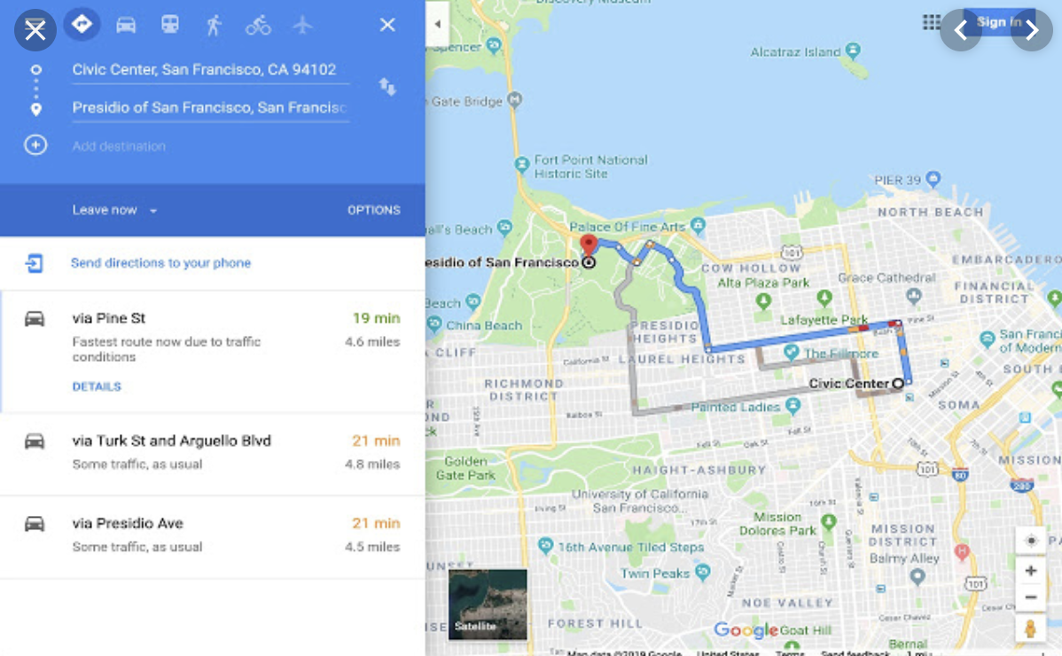
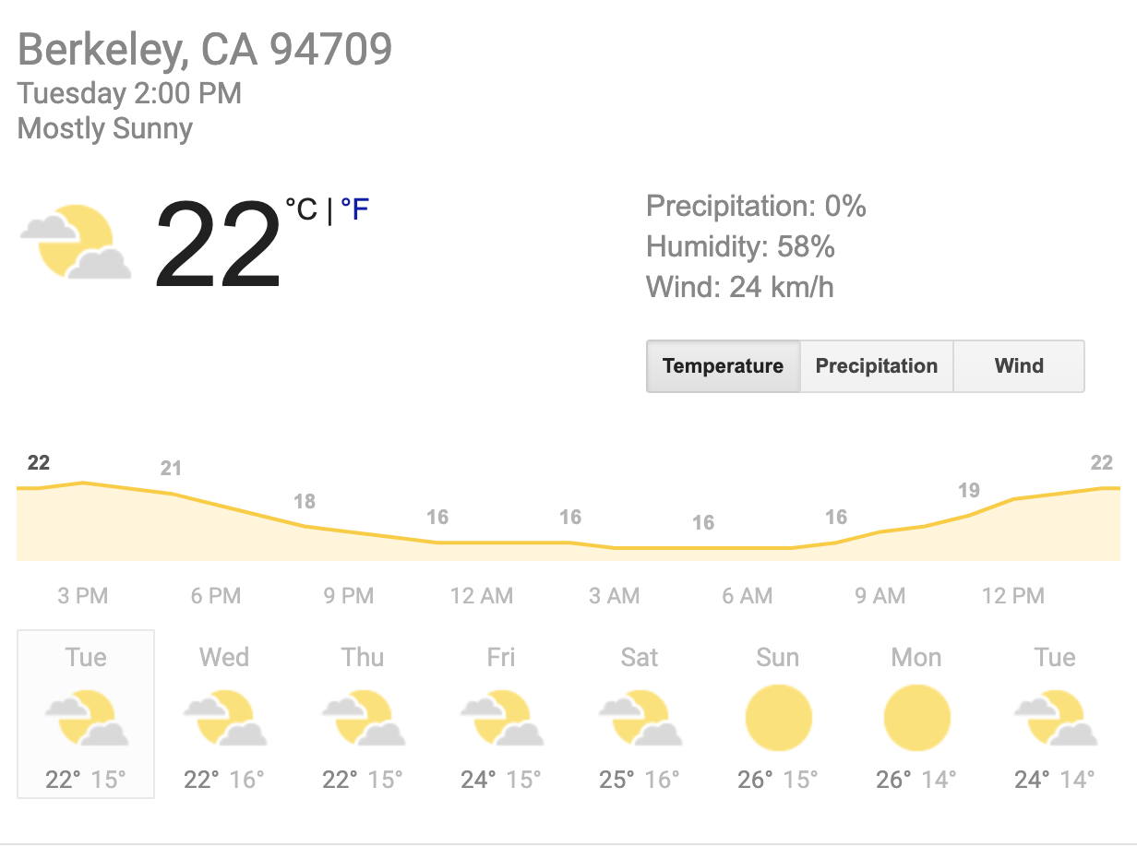
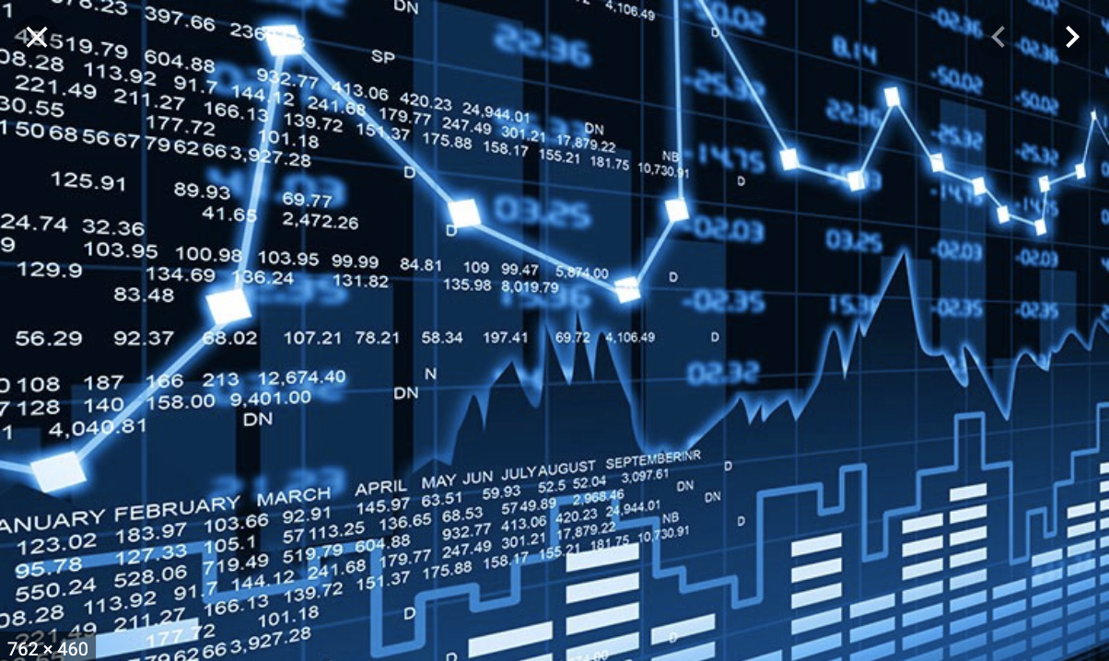
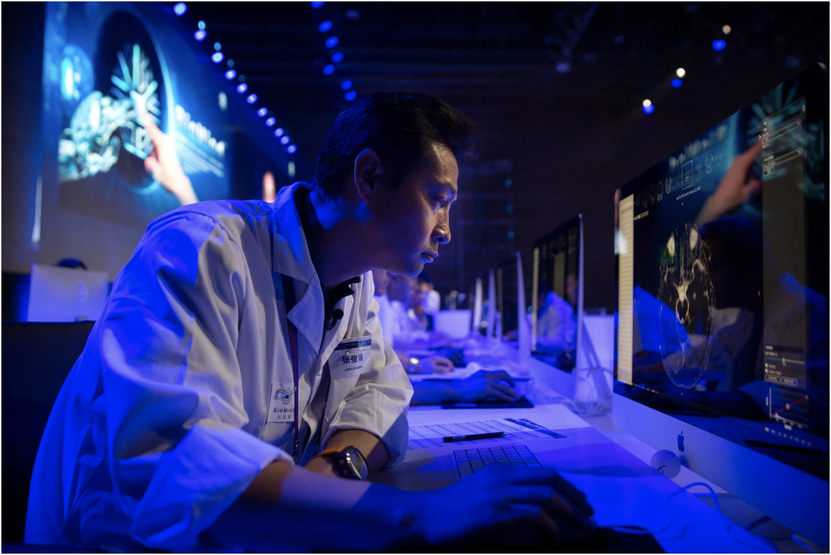
Tools for Predictions & Decisions
Notes:
Many more tools for prediction: Google maps, netflix (amazing recommendation engine)

Slide 18
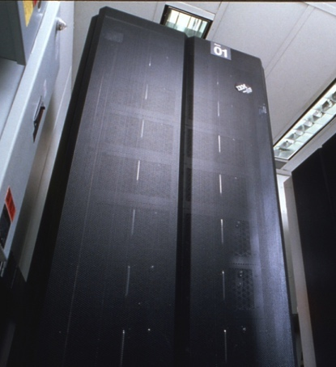
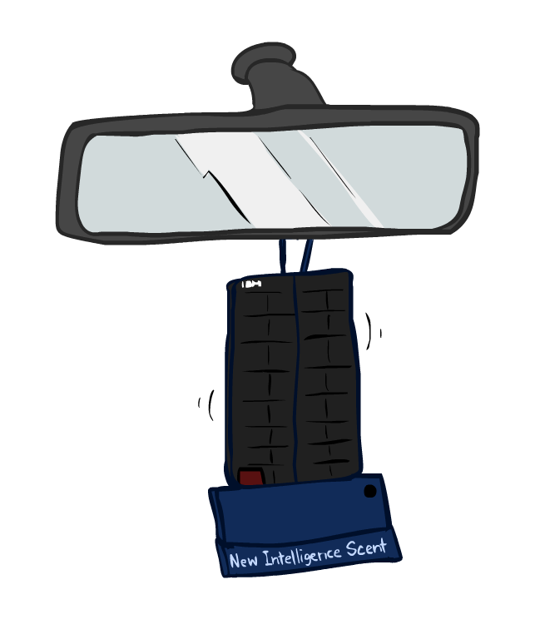
Game Agents
Classic Moment: May, '97: Deep Blue vs. Kasparov
First match won against world champion
“Intelligent creative” play
200 million board positions per second
Humans understood 99.9 of Deep Blue's moves
Can do about the same now with a PC cluster
1996: Kasparov Beats Deep Blue
“I could feel --- I could smell --- a new kind of intelligence across the table.”
1997: Deep Blue Beats Kasparov
“Deep Blue hasn't proven anything.”
Text from Bart Selman, image from IBM’s Deep Blue pages
Notes:
International Business Machines Co.
- Leveraged increase computation to solve trees faster
Yeah, Kasparov comment probably says more about humans than about computers.
In over two decades, what game are we solving now?
Transition: Do we want to solve one problem or many? How do humans handle this?

Slide 19

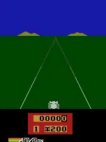
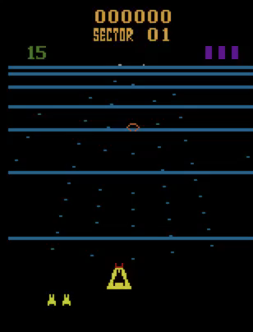
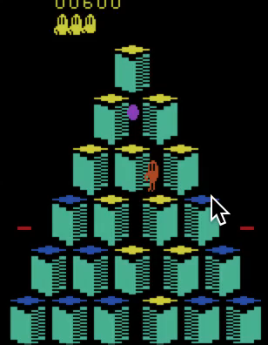
Game Agents
Reinforcement learning
Pong
Enduro
Beamrider
Q*bert
Notes:
Pixels as the perception! Way harder. Way more games, but fun
What can using pixels in the real world (cameras) give us.

Slide 20
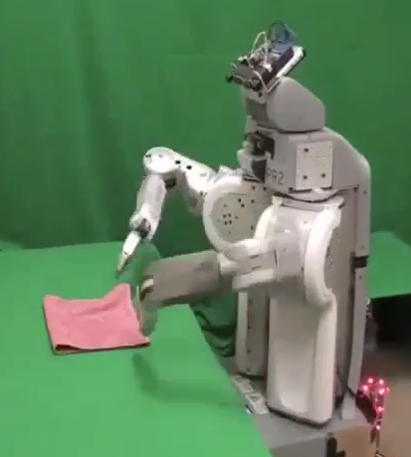
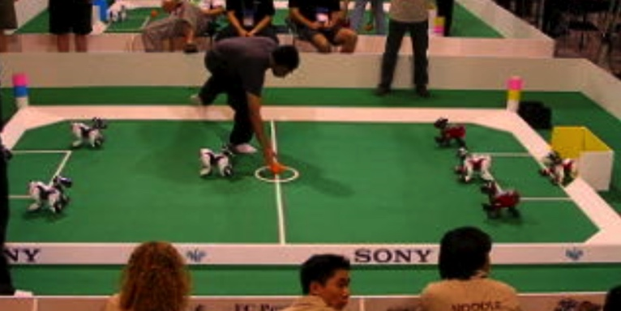
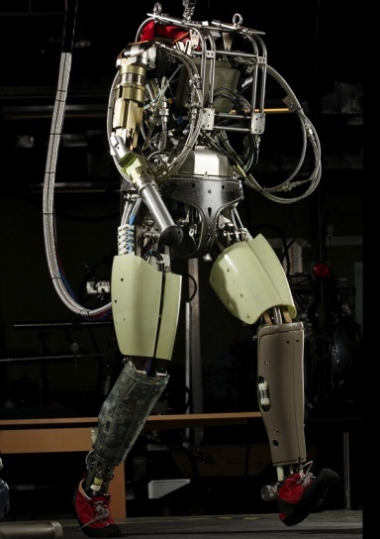
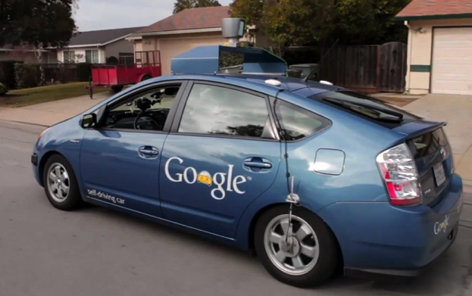
Robotics
Robotics
Part mech. eng.
Part AI
Reality much
harder than
simulations!
Technologies
Vehicles
Rescue
Help in the home
Lots of automation…
In this class:
We ignore mechanical aspects
Methods for planning
Methods for control
Images from UC Berkeley, Boston Dynamics, RoboCup, Google

Slide 21
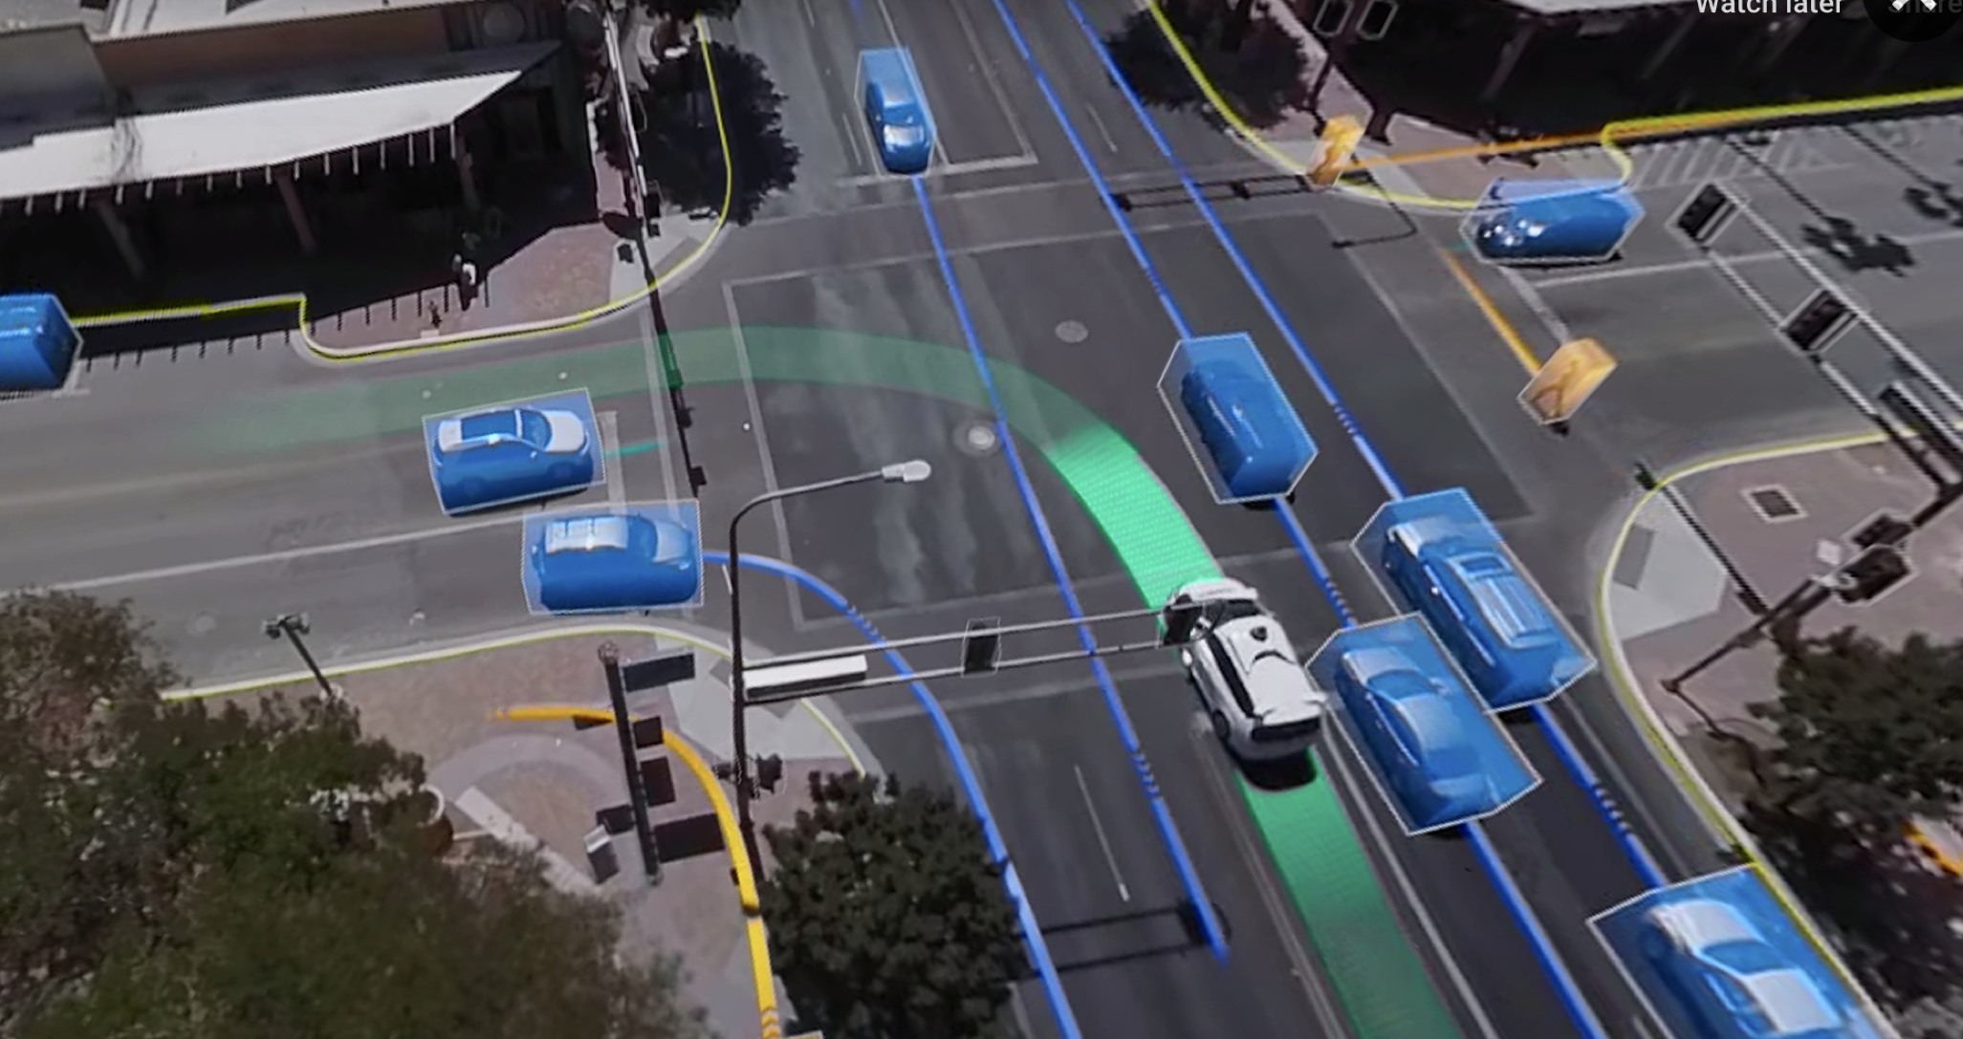
Notes:
One of my favorite applications to consider is self driving cars – the potential for benefit is immense, but it is so hard:
- continuous
Multi agent
Partially observed (don’t know what is fully going on)
Weather
What would even a sub problem look like?

Slide 22
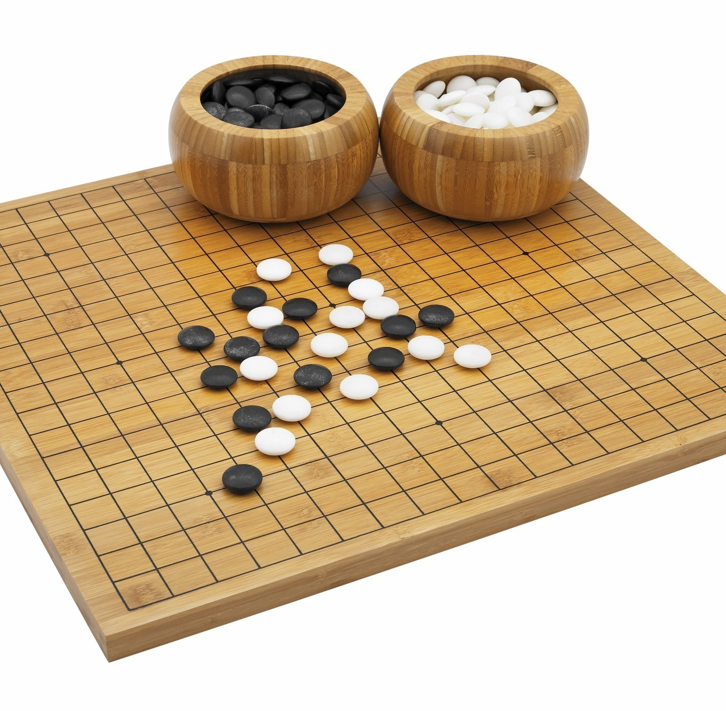
Utility?
Clear utility function
Not so clear utility function
Notes:
Does the clear utility function in games even always give us desired behavior?
No!
It is even tricker in robotics
In my work I have quadrotors learn to fly, and the flight time is the only metric. So, the robot learns that max thrust is a good action mode, and rockets itself straight up sometimes.

Slide 23
Designing Rational Agents
An agent is an entity that perceives and acts.
A rational agent selects actions that maximize its (expected) utility.
Characteristics of the percepts, environment, and action space dictate techniques for selecting rational actions
This course is about:
General AI techniques for a variety of problem types
Learning to recognize when and how a new problem can be solved with an existing technique
Sensors
Agent
Percepts
Environment
?
Actuators
Actions
Notes:
Quick recap: what will we do in this class?

Slide 24
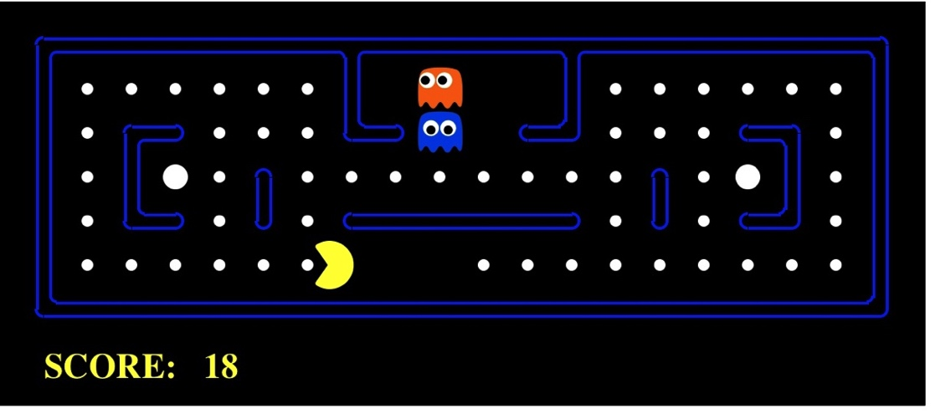
Pac-Man as an Agent
Agent
Environment
Sensors
Percepts
?
Actuators
Actions
Pac-Man is a registered trademark of Namco-Bandai Games, used here for educational purposes
Notes:
Pac man! How many of you have played this game? It’s surprisingly hard, but you’ll solve it in this class!

Slide 25
Maximize Your
Expected Utility

